Slide 1



MINOR PROJECT BATCH – ANTI SLEEP DRIVING SENSOR
By
SANJAI K [21BEC177]
SARANKUMAR K [21BEC185]
SARVESH M D [21BEC188]
DATE:07/03/2023
GUIDE
Dr.E.DINESH M.E.,PHD

Slide 2
ABSTRACT
As the number of road accidents are increasing, it constitutes to increased human loss during many instances.
Accidents will primarily occur due to rash driving, over speed and other related parameters.
Hence, it develops an increased necessity to avoid the road accidents and save the human lives.
The device also has some additive features like total vehicle health report, wherein the users can download the details about vehicle movement.
The proposed technology can be effectively used for improving and safeguarding human lives for developing a better future.

Slide 3
INTRODUCTION
Anti-sleep driving sensors are advanced safety technologies that are designed to detect the onset of drowsiness or fatigue in drivers and alert them before they fall asleep behind the wheel.
These sensors can help prevent accidents caused by drivers who are too tired to drive safely.
There are several types of anti-sleep driving sensors available on the market. Here are some of the most common types

Slide 4
Steering Wheel Sensors: These sensors monitor the driver's grip on the steering wheel. If the driver's grip becomes loose or erratic, indicating they are not in control of the vehicle, an alarm will sound to alert them to pull over and rest.
Eye Tracking Sensors: These sensors use cameras and infrared technology to monitor the driver's eyes and detect signs of fatigue, such as drooping eyelids or prolonged periods of closed eyes. When the sensors detect these signs, an alarm will sound to alert driver.

Slide 5
Head Position Sensors: These sensors use infrared technology to detect the driver's head position and posture. If the driver's head droops or nods, indicating they are falling asleep, an alarm will sound to alert them to pull over and rest.
Heart Rate Sensors: These sensors use ECG (Electrocardiography) technology to monitor the driver's heart rate. If the driver's heart rate drops below a certain level, indicating they are falling asleep, an alarm will sound to alert them.

Slide 6
HARDWARE COMPONENTS
555 Timer IC
Buzzer
Resistors
Capacitors
Transistors
Cables and Connectors
Relays
Diodes
PCB and Breadboards
LED
Transformer/Adapter
Push Buttons
Switch
IC Sockets

Slide 7
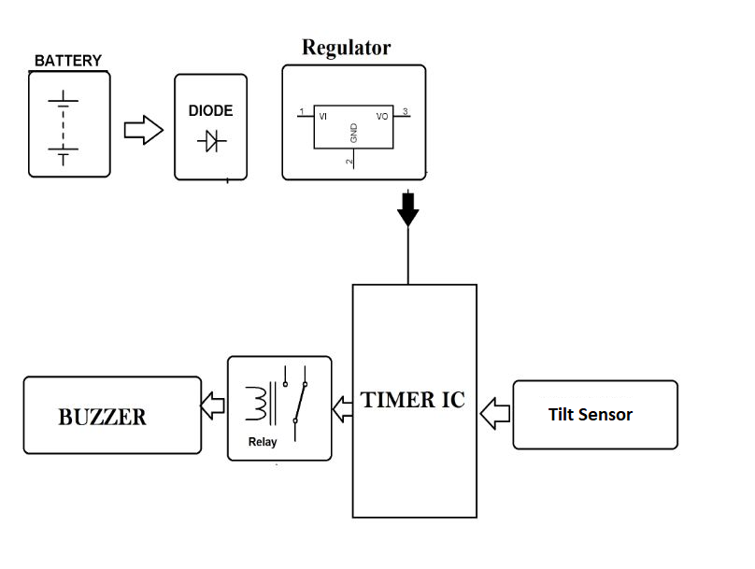
BLOCK DIAGRAM

Slide 8
OUTPUT

Slide 9
CONCLUTION
This system is useful especially for people who travel long distances and people who are driving late at night. The circuit is built around Schmitt trigger, timer IC, transistor, a relay and a logic gate.
Around half an hour after the reset of timer IC, transistors rive the buzzer to sound an intermediate beep. If timer IC is not reset at that time, around one minute later the output of gate conducts.
Due to this the clock stops counting further and relay energizes to deactivate the load. This state changes only reset switch is pressed.
As a result of pressing the reset switch a next timer is set which will trigger the same events after half an hour.

Slide 10
REFERENCE
M. Abdelsalam and T. Bonny, “IoV Road Safety: Vehicle Speed Limiting System,” 2019 International Conference on Communications, Signal Processing, and their Applications (ICCSPA), Mar. 2019.
S. K. Singh, “Road Traffic Accidents in India: Issues and Challenges,” Transportation Research Procedia, vol. 25, pp. 4708–4719, 2017.
M. Virant and M. Ambrož, “Universal Safety Distance Alert Device for Road Vehicles,” Electronics, vol. 5, no. 4, p. 19, Apr. 2016.
https://nevonprojects.com/driver-anti-sleep-device/

